Slide 1

Malignant comment

Slide 2
PROBLEM STATEMENT AND UNDERSTANDING

Slide 3
Now people are using social media for daily use. Some people are addicted to that, they spent more times in it. People can express their opinion through comment for a subject or other purposes. Some of them were used to write the comments in abusive language, aggression, cyberbullying, hatefulness and many others has been identified as a major threat on online social media platforms. Social media platforms are the most prominent grounds for such toxic behaviour.
Especially the celebrities, we can say that female celebrities. They are facing such toxic behaviour from people. This can take a toll on anyone and affect them mentally leading to depression, mental illness, self-hatred and suicidal thoughts.
Our goal is to build a prototype of online hate and abuse comment classifier which can used to classify hate and offensive comments so that it can be controlled and restricted from spreading hatred and cyberbullying.

Slide 4
Eda steps and visualizations

Slide 5
EDA STEPS
We have separate data for training and testing.
First of all check for the missing values, there is no missing values present in dataset.
Check for Skewness it’s fine.
Since we have the feature comment which have text, I perform some NLP pre processing.
Remove the punctuation other symbols white space etcetera form the text.
Using word cloud module visualize the offensive words from comments
We have highly malignant, malignant, rude, loathe, abuse, threat comments, I check the most type of comments using pie chart.
And the visualization I observe that most of the comments were malignant comments
Dataset have ID column of the comment, encoded it using label encoder.
Lemmatization done on the comment text and perform Vectorization on it.
The all above steps done on test dataset also.

Slide 6
VISUALIZATIONS

Slide 7
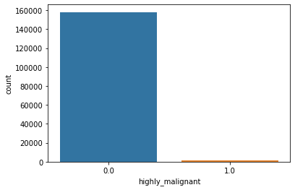
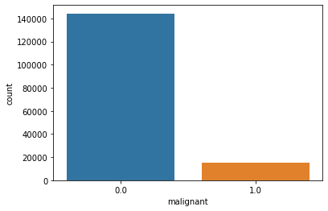
COUNTS

Slide 8
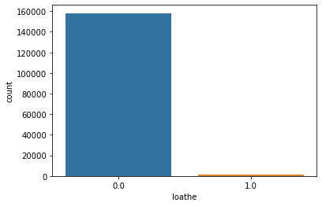
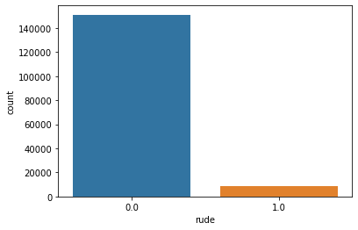

Slide 9
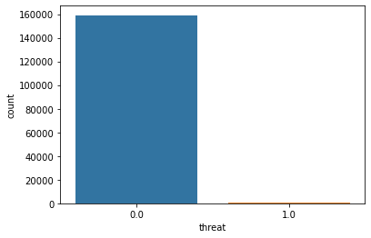
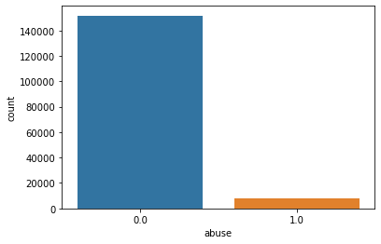

Slide 10
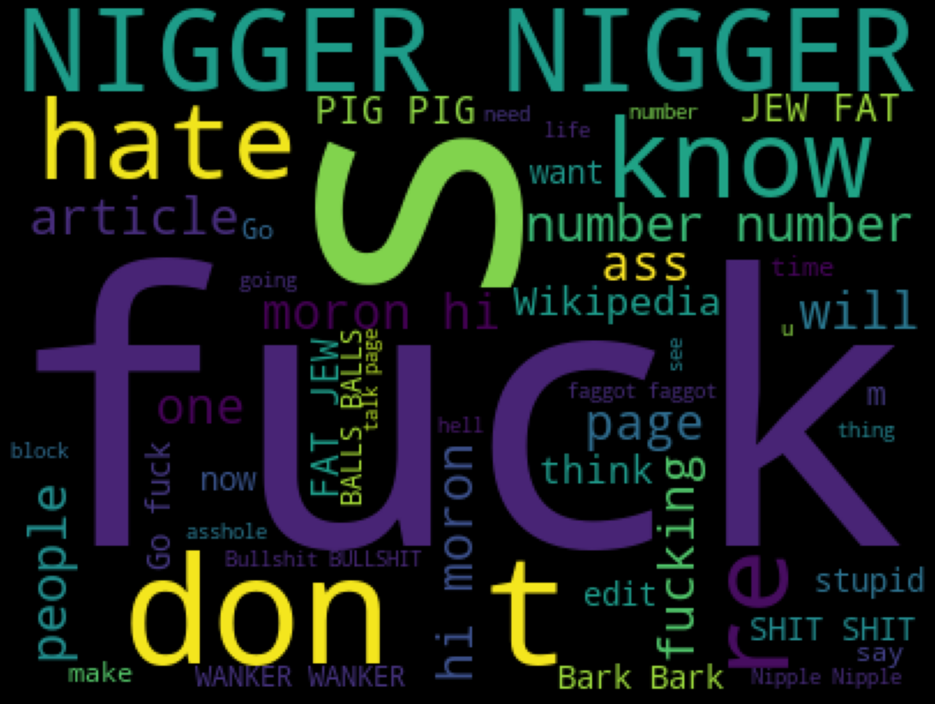
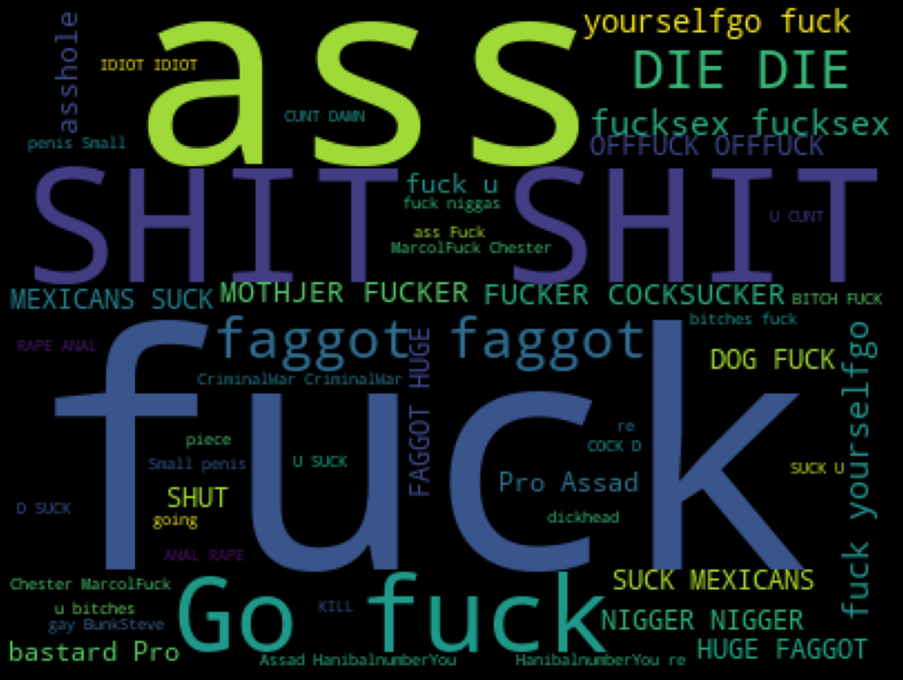
OFFENSIVE COMMENTS
MALIGNANT
HIGHLY MALIGNANT

Slide 11
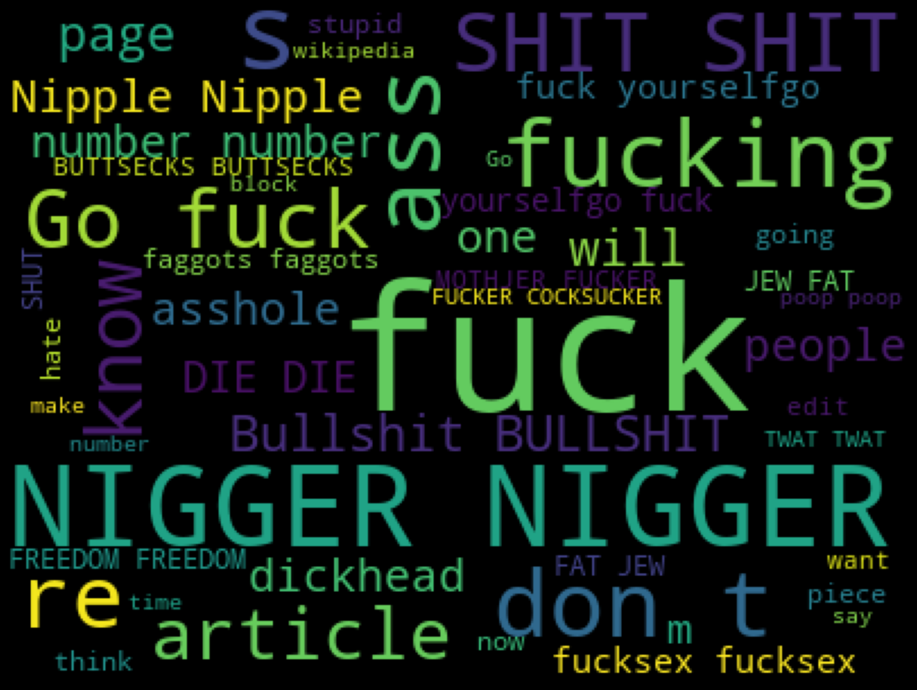
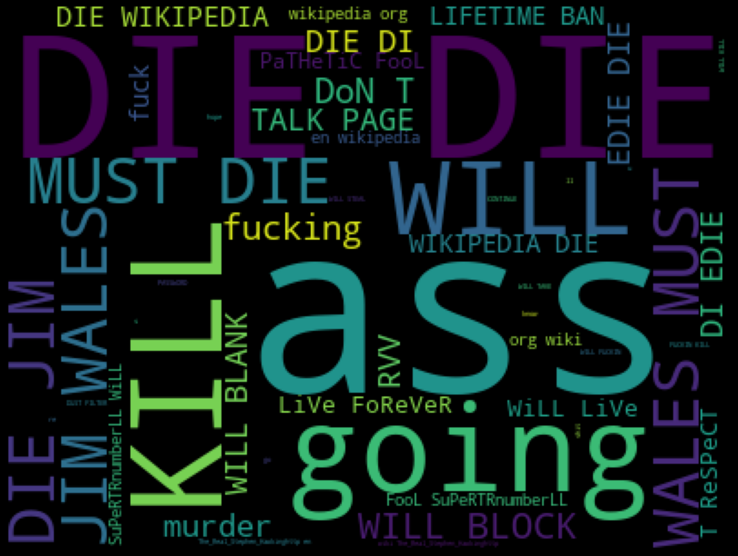
RUDE
THREAT

Slide 12
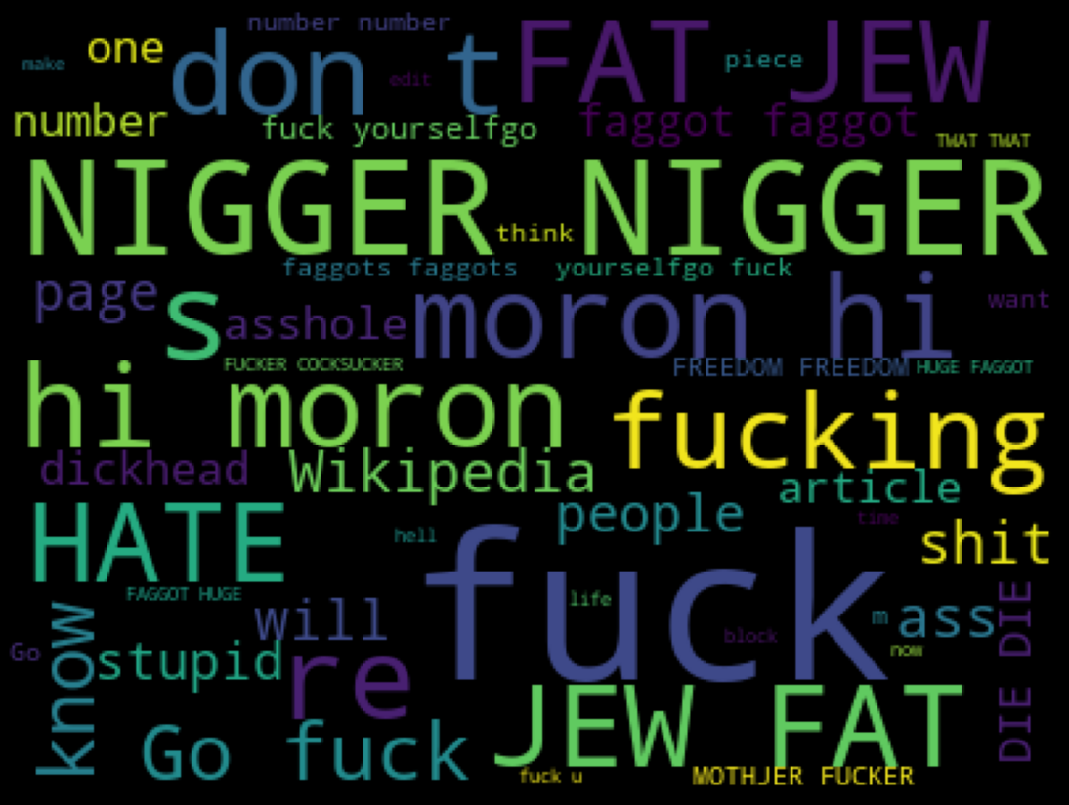
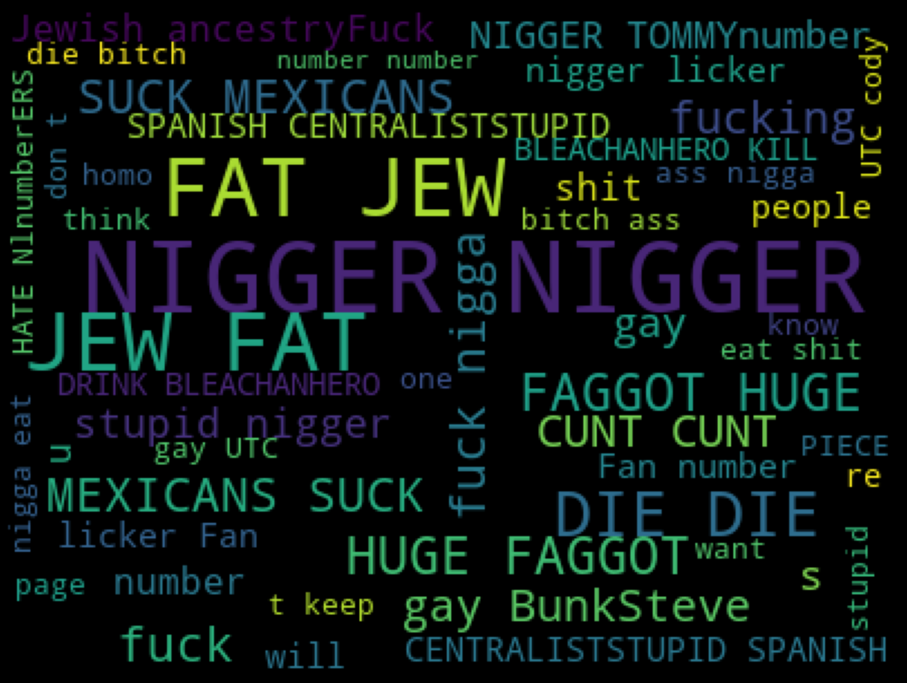
ABUSE
LOATHE

Slide 13
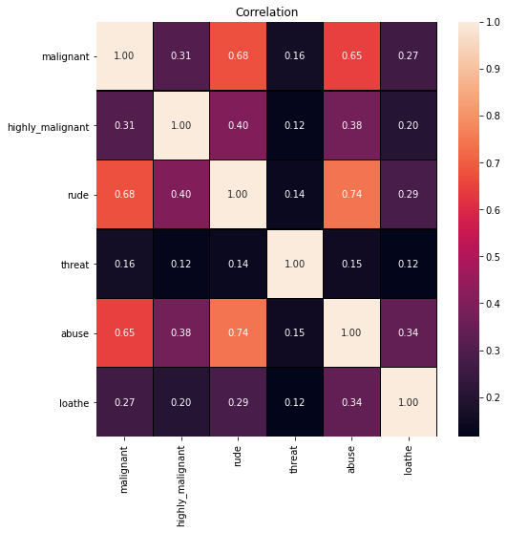
CORRELATION

Slide 14
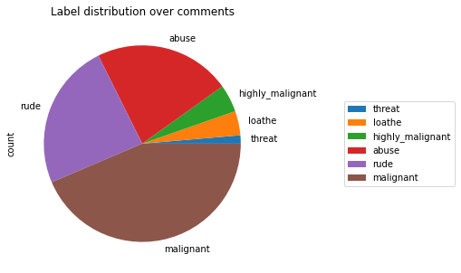
PIE CHART

Slide 15
STEPS AND ASSUMPTIONS

Slide 16
We can recognize the offensive comment, but machine can’t we want to learn the machine that which is offensive or not.
We have different category of comments, like malignant, highly malignant, loathe, abuse, rude, threat.
We can criticize people or celebrities, but beyond that it may be a threat or something.
By analysing the data I observe that most of the comments were malignant among other categories.
Visualize the offensive word using word cloud and understands the offensive words.
In the given dataset most of dataset were not the malignant or other categories of the comments.
These are the steps and approach taken for completing the project.

Slide 17
MODEL DASHBOARD
FINALIZED MODEL

Slide 18
Here for this project I used four different models.
They are Multinomial naïve bayes, random forest, decision tree and linear SVC
All models performed well, have the accuracy above 90% but decision tree and random forest is very slow compared to other two models.
To finalise the model I compare their Cross validation score and accuracy score.
By comparing I observe that all models have equal cross validation score and accuracy score.
So it is difficult to finalize the model, but I choose multinomial NB as my final model.
Because it is faster than other models,
Tuned with parameters and select the best parameters and run it and get accuracy of 90%.

Slide 19
CONCLUSION

Slide 20
If we have a strong cyber security system we can all stop this type of toxic comments.
Many of people were comment on their fake id, who is fear to show their identity, the cyber police can track them and catch them
In social media everything goes viral in seconds. It means lot of people around the world were using these platforms.
Some people uses it for benefits and some don’t.
So in this project we uses to recognize such comments using machine learning.
All the solutions are not stable for long time.
At time changes we want to find better solution for that time.

